Slide 1





AMAZON SALES
DATA ANALYZING
By Nunna Venkata Sravya

Slide 2

INTRODUCTION
Understanding and analyzing Amazon sales data can unlock valuable insights to drive business growth. This presentation will explore the key challenges, data architecture, visualization techniques, and predictive analytics methods to optimize Amazon sales performance.

Slide 3
PROBLEM STATEMENT
Sales management has gained importance to meet increasing competition and the need for improved methods of distribution to reduce cost and to increase profits. Sales management today is the most important function in a commercial and business enterprise.

Slide 4
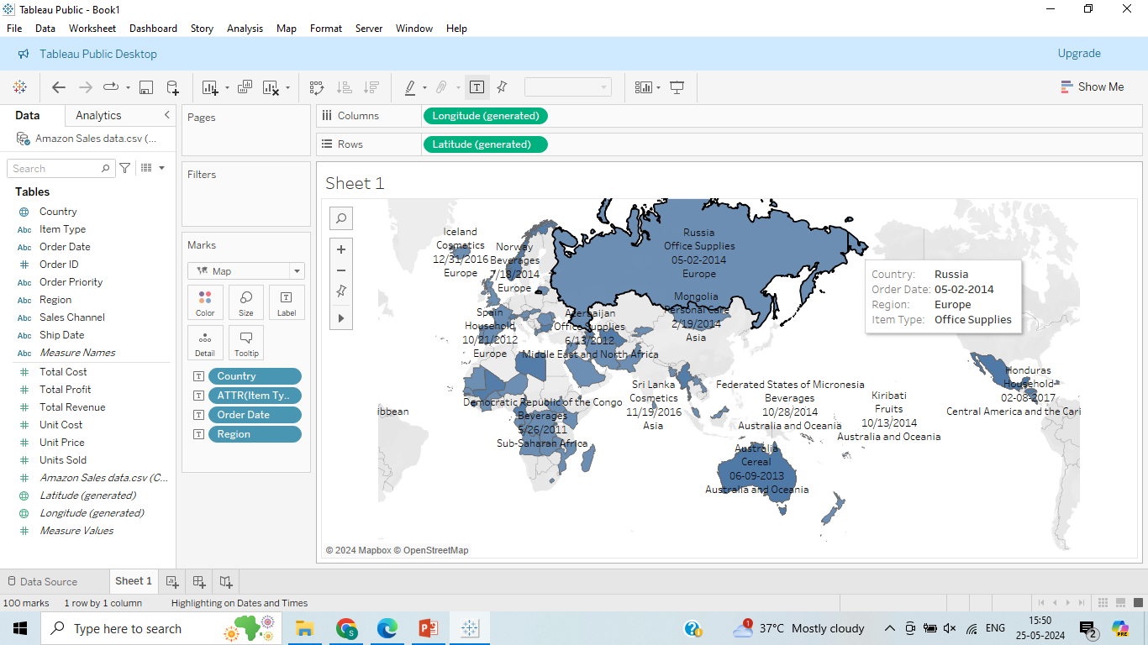
In Tableau, create a dashboard to analyze Amazon sales data by visualizing sales trends over time, geographical distribution, and product performance across different regions and item types, with interactive filters for detailed insights.

Slide 5
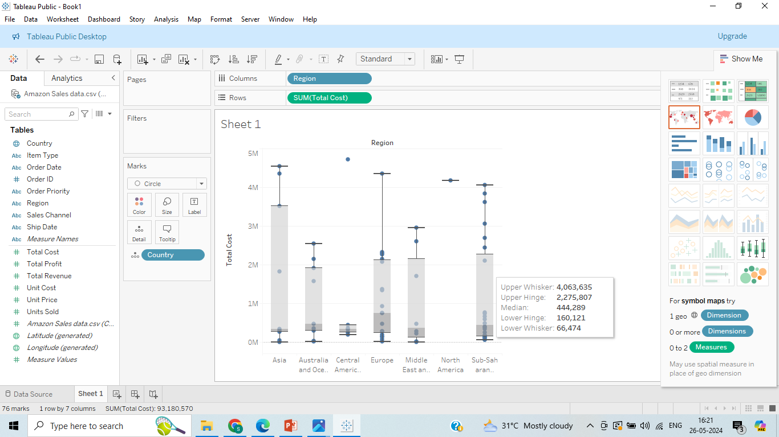
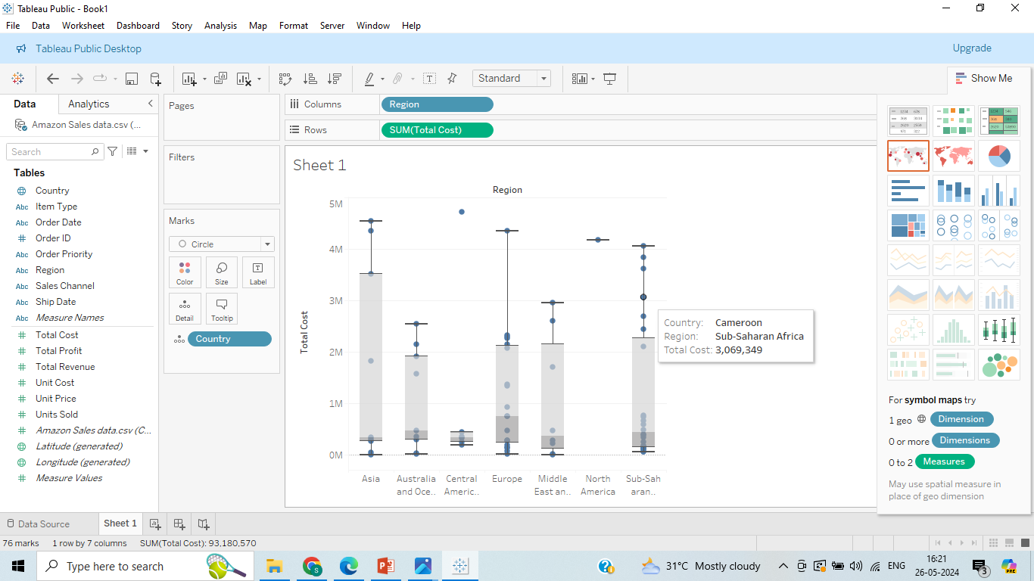
To visualize the distribution of sales across countries within each region by placing region on the columns shelf, sales on the rows shelf, and country on the detail shelf, providing a clear view of sales variations and outliers within regions.

Slide 6
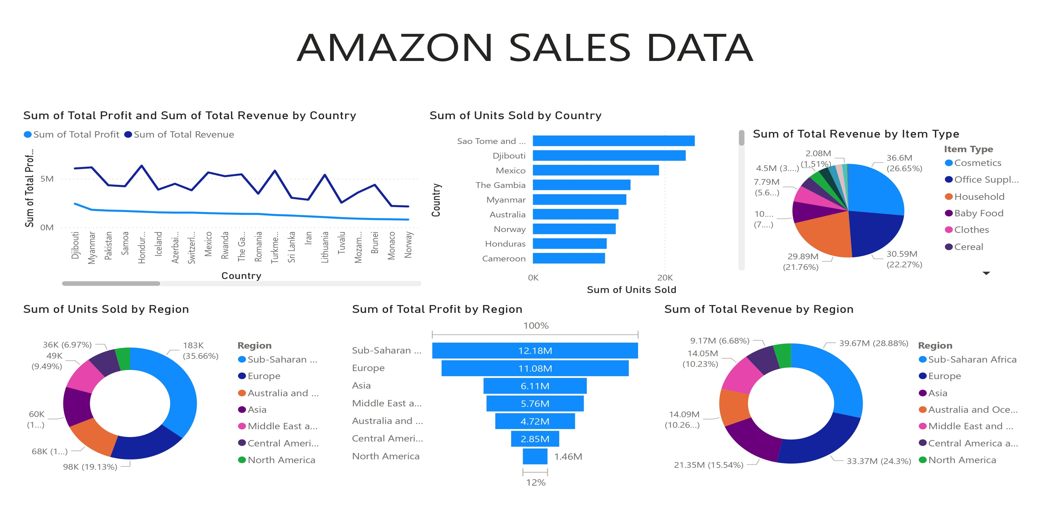
MY DESIGN

Slide 7
Thank you

